Slide 1
SHADOWFOX | MACHINE LEARNING ENGINEER INTERNSHIP
Machine Learning Engineer Internship
Project Showcase
BEGINNER · WEEK 1
Boston House Price Prediction
INTERMEDIATE · WEEK 2
Car Selling Price Prediction
Three projects, three levels: from regression on housing data to an NLP feedback-intelligence platform
ADVANCED · WEEKS 3–4
ReviewMind AI
Samarth Jain · B.Tech AI-ML (IAC), Sage University, Indore · Program ID SF-PID-2026-W7613 · 1–30 November 2026
Notes:
Introduce the internship and the three projects, one per level.

Slide 2
Internship Overview
1 month
3 levels
3 projects
Program timeline
Week 1
Beginner project
1–30 Nov 2026
Beginner, Intermediate, Advanced
one per level
1
Virtual Internship Program at ShadowFox, role: Machine Learning Engineer Intern
Each project followed a full workflow: data inspection, preparation, modelling, evaluation and reporting
Every project was documented with a report and a presentation, including its limitations
Week 2
Intermediate project
2
Week 3
Advanced project
3
Week 4
Advanced project and submission Q&A
4
Notes:
The weekly structure comes from the ShadowFox offer letter.

Slide 3
Internship Objectives
Apply the full ML workflow
Inspect, clean, explore, model, evaluate and report on each dataset
Compare models fairly
Train several models and judge them with MAE, MSE, RMSE, R², accuracy, F1 and ROC-AUC
1
2
Progress in complexity
Tabular regression first, then NLP with classical and transformer models
Package and build
Save a reusable model; build a modular Streamlit application
3
4
Document honestly
Reports, presentation and GitHub, with limitations stated openly
5
Notes:
Objectives are drawn from the three project reports.

Slide 4
Technologies and Tools Used
Boston House Price
Car Selling Price
ReviewMind AI
Python, Pandas
Matplotlib, Seaborn
Scikit-learn: 5 regressors, SimpleImputer, StandardScaler, Pipeline
Jupyter Notebook
Git and GitHub
Python, Pandas, NumPy
Matplotlib, Seaborn
Scikit-learn: ColumnTransformer, OneHotEncoder, RandomizedSearchCV
Joblib (.pkl model file)
Jupyter Notebook
Python 3.11.9, Streamlit
Scikit-learn: TF-IDF, Logistic Regression, NMF
PyTorch (CPU), Hugging Face Transformers
Pretrained DistilRoBERTa for emotion
Joblib, Git and GitHub
Notes:
Tools listed are those recorded in each project report.

Slide 5
Project Roadmap
BEGINNER
Week 1
INTERMEDIATE
Week 2
ADVANCED
Weeks 3–4
Boston House Price Prediction
Car Selling Price Prediction
ReviewMind AI
›
›
Regression · 506 records
Regression · 299 records
NLP · 49,582 reviews
Best result
Best result
Best result
Random Forest
R² 0.8752
Gradient Boosting (baseline)
R² 0.7530
Logistic Regression
Accuracy 90.52%
Notes:
Roadmap of the three projects with the headline result of each.

Slide 6
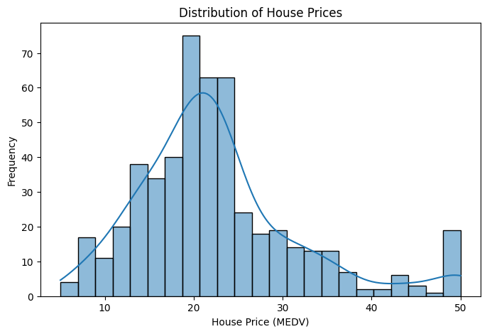
Boston House Price Prediction
BEGINNER
Week 1
Predict the median home value (MEDV) of a Boston-area tract from 13 housing, neighbourhood and socioeconomic features: a supervised regression problem.
506
13
records, 14 columns
input features
120
404 / 102
missing values imputed
train / test split
Target MEDV: mean 22.53, capped at 50.0 (16 houses)
Strongest features: LSTAT (r −0.723), RM (+0.695), PTRATIO (−0.508)
Distribution of house prices (MEDV)
Notes:
The target appears capped at 50.0. Imputation: median for numeric columns, mode for CHAS.

Slide 7
Boston: Methodology and Results
BEGINNER
Week 1
1
Impute missing values
R² 0.8752
2
Split 80/20 (seed 42)
Random Forest: best overall
3
Train 5 regressors
MSE 9.1504
4
Evaluate MAE, MSE, R²
Random Forest: lowest MSE; MAE 2.2140
Imputation was done before the split; a check showed only third-decimal changes in the metrics.
MAE 2.0810
SVR: lowest MAE; Linear Regression R² 0.6591
Notes:
Random Forest: MAE 2.2140, MSE 9.1504, RMSE 3.0249, R2 0.8752. SVR has the lowest MAE. Only 102 test records.

Slide 8
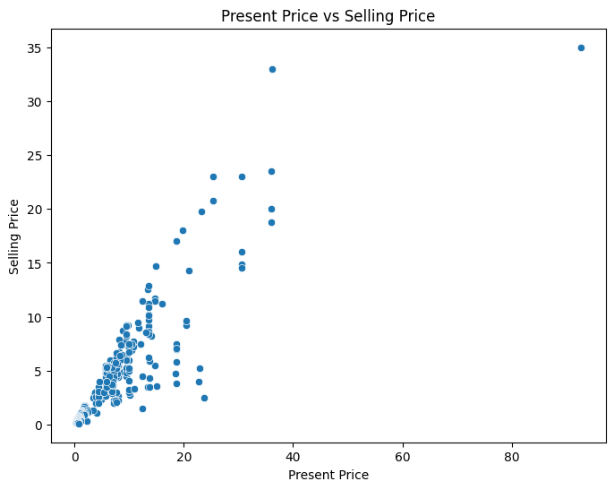
Car Selling Price Prediction
INTERMEDIATE
Week 2
Predict the selling price of a used vehicle from its present price, kilometres driven, owners, age, fuel type, seller type and transmission.
299
7 → 11
records after 2 duplicates removed
selected features → encoded columns
Car_Age
239 / 60
engineered: 2018 − Year
train / test split
Present_Price vs Selling_Price (r = 0.88)
Noted in the report: the file mixes 198 cars and 101 two-wheelers with very different price ranges.
Present_Price is by far the strongest signal; Kms_Driven shows almost no linear link (r = +0.029).
Notes:
Prices are treated as relative values; the currency is not documented.

Slide 9
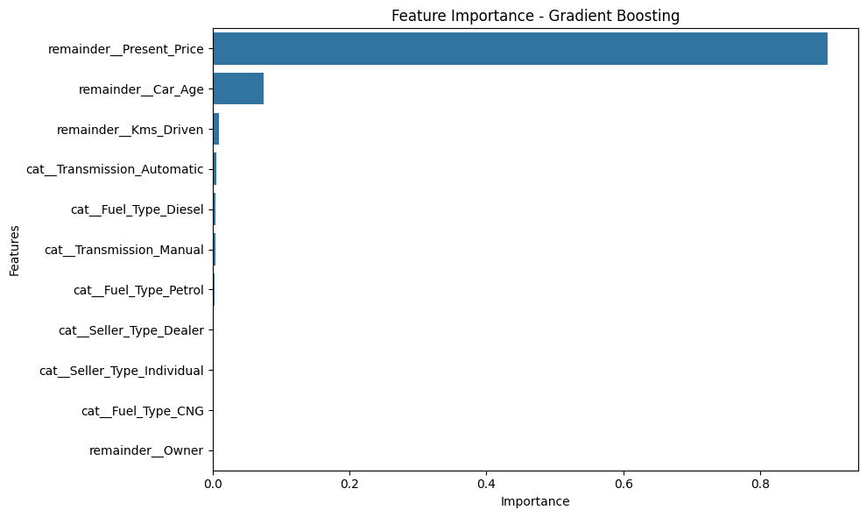
Car: Methodology and Results
INTERMEDIATE
Week 2
5 baselines + Random Forest and Gradient Boosting tuned with RandomizedSearchCV (50 combinations, 5-fold CV)
R² 0.7530
MAE 1.1349
Gradient Boosting (baseline)
RMSE 2.5232; Linear Regression R² 0.7528
Feature importance (baseline Gradient Boosting)
Present_Price ≈ 89.85%, Car_Age ≈ 7.49%. Tuning did not beat the baseline on this split.
Notes:
Gradient Boosting and Linear Regression are practically tied on R2 and RMSE; MAE differs (1.1349 vs 1.4729). Best CV RMSE: RF 1.5436, GB 1.3817.

Slide 10
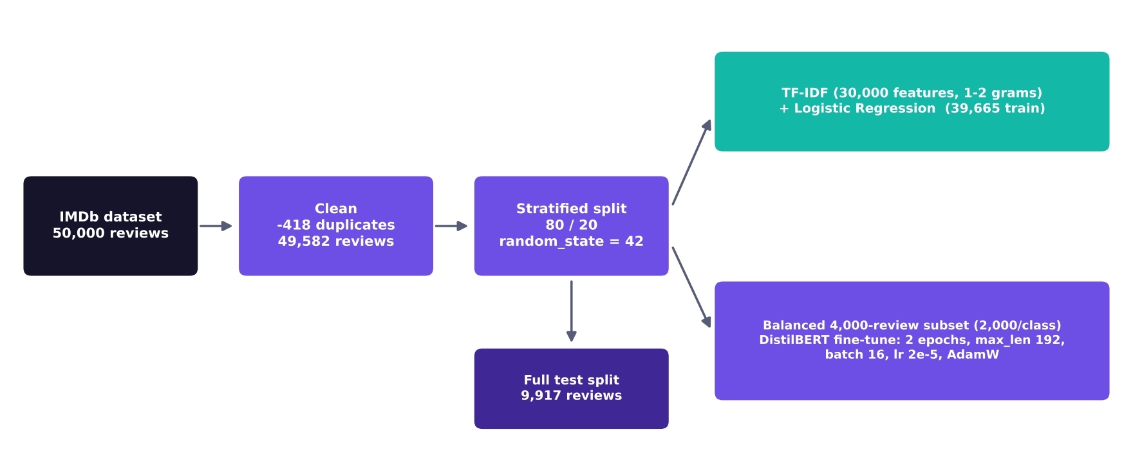
ReviewMind AI: Introduction
ADVANCED
Weeks 3–4
Universal Customer Feedback Intelligence Platform: turns raw review text into sentiment, emotion and topic insight through an interactive Streamlit app, running locally without paid APIs.
49,582
9,917
IMDb reviews after cleaning
held-out test reviews
Model-development pipeline for the sentiment models
3
10 / 10
Accepts CSV or Excel files, detects text and label columns
Quantitative evaluation was done on IMDb data only
analyses: sentiment, emotion, topics
backend checks passed
Notes:
Backend integration notebook recorded 10 of 10 checks passed.

Slide 11
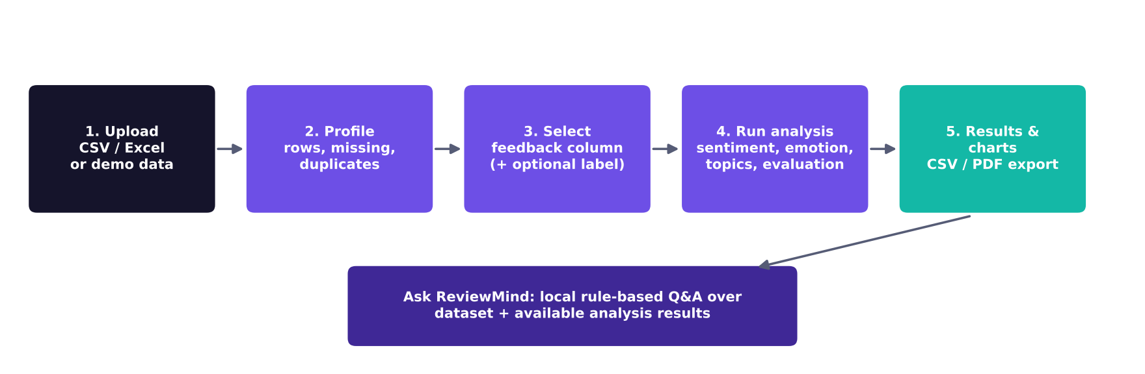
ReviewMind AI: Architecture and Features
ADVANCED
Weeks 3–4
1
2
3
4
Sentiment
Emotion
Topics
Ask ReviewMind
TF-IDF + Logistic Regression or fine-tuned DistilBERT
Pretrained DistilRoBERTa (not fine-tuned): joy, sadness, surprise, disgust, fear, neutral
TF-IDF + NMF, 5 topics, dominant topic per review
Local rule-based assistant over the dataset and results
Notes:
Modular backend: data_loader, data_profiler, preprocessing, sentiment, emotion, topics, evaluation, analysis_engine, assistant_engine, visualization, exporter.

Slide 12
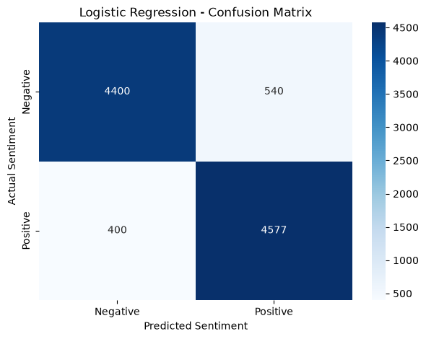
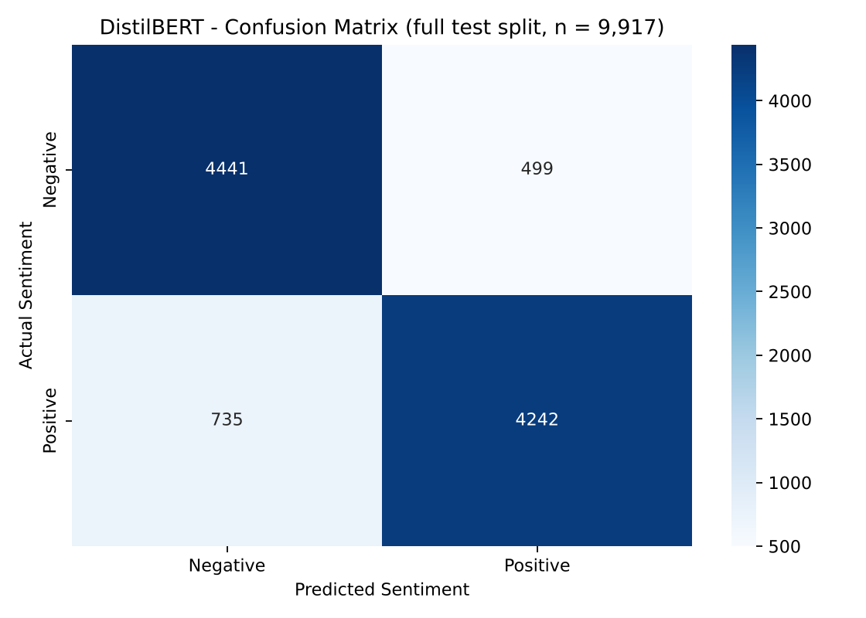
ReviewMind AI: Model Performance and Dashboard
ADVANCED
Weeks 3–4
Streamlit workspaces
Overview
Analyze
Visualizations
Exports
Key Terms
Confusion matrices: Logistic Regression (left), DistilBERT (right)
DistilBERT was fine-tuned on only 4,000 reviews for 2 epochs on a CPU, so this is not a general ranking of the architectures.
90.52%
87.56%
LR accuracy
DistilBERT accuracy
Notes:
No screenshots of the running Streamlit interface were supplied, so none are shown. LR: precision 0.8945, recall 0.9196, F1 0.9069, AUC 0.9663. DistilBERT: precision 0.8947, recall 0.8523, F1 0.8730, AUC 0.9501.

Slide 13
Comparison of All Three Projects
 | Boston House Price | Car Selling Price | ReviewMind AI
Level | Beginner · Week 1 | Intermediate · Week 2 | Advanced · Weeks 3–4
Task | Regression | Regression | Sentiment, emotion, topics; app
Data | 506 records, 13 features | 299 records, 7 features | 49,582 reviews
Test set | 102 records | 60 records | 9,917 reviews
Models | 5 regressors | 5 baselines + 2 tuned | LR, DistilBERT, DistilRoBERTa, NMF
Best result | Random Forest: R² 0.8752 | Gradient Boosting: R² 0.7530 | Logistic Regression: 90.52% acc.
Deliverable | Notebook, reports | Notebook, .pkl model, reports | Streamlit app, GitHub repo, reports
Each project reports its own caveats: small test sets, preprocessing before the split, exploratory test-set use, single-domain training data.
Notes:
Metrics are not comparable across projects because tasks and metrics differ.

Slide 14
Skills and Learning Outcomes
1
2
3
Machine learning concepts
Data analysis
Model evaluation
Regression, ensembles, TF-IDF, transformers, NMF; generalisation vs training loss
Missing values, duplicates, outliers, correlations, feature engineering
MAE, MSE, RMSE, R², F1, ROC-AUC; fair comparison on identical test data
4
5
6
Python development
Application development
Deployment and GitHub
Pandas, scikit-learn pipelines, a PyTorch training loop, modular code
Streamlit app, CSV and PDF export, integration tests (10 / 10)
Joblib model files, run instructions, GitHub; local deployment only
Notes:
Learning outcomes correspond to Section 5 of the report.

Slide 15
Challenges and Future Improvements
Challenges faced
Future improvements
No GPU: DistilBERT trained on a 4,000-review subset (about 35.7 minutes)
Noisy data: 418 duplicates and HTML markup in IMDb; 120 missing values in Boston
Small data: 102 and 60 test records, mixed cars and two-wheelers
Heavy model weights cannot live in the GitHub repository
Pipelines, cross-validation and tuning to avoid leakage
Evaluate on real customer-feedback datasets
Fine-tune DistilBERT on the full data with a GPU
Wrap the saved models in simple apps; add a hosted demo
Notes:
Challenges and next steps are taken from the project reports.

Slide 16
Final Conclusion
R² 0.8752
Boston: Random Forest
R² 0.7530
Car: Gradient Boosting (baseline)
90.52%
ReviewMind AI: Logistic Regression accuracy
Three levels, one workflow: inspect, prepare, model, evaluate and report.
Models were compared on identical held-out data, with training conditions and limitations stated openly.
Next: leakage-safe pipelines, cross-validation and real customer-feedback data.
Notes:
Closing summary.

Slide 17
Thank You
Samarth Jain · Machine Learning Engineer Intern, ShadowFox
Sage University, Indore · B.Tech AI-ML (IAC) · Program ID SF-PID-2026-W7613
ReviewMind AI repository: github.com/samarthjain-ai/ShadowFox-ML-Internship
Notes:
Invite questions.

